Slide 1
Blockchain-enabled Invoice management system
By Team 12

Slide 2
PROBLEM STATEMENT
In the dynamic world of business, efficiently handling invoices is crucial. However, when dealing with a wide range of suppliers and items, the creation, management, and reconciliation become complex challenges.
An invoice management system based on blockchain's immutable, transparent, and decentralized characteristics offers a secure and streamlined platform for overseeing invoices.

Slide 3
Why a solution is necessary ??
Traditional systems may lack transparency, making it challenging for stakeholders to access real-time information.
Common disputes due to unclear invoice lifecycle visibility.
Conventional systems may be susceptible to security breaches, putting sensitive financial information at risk

Slide 4
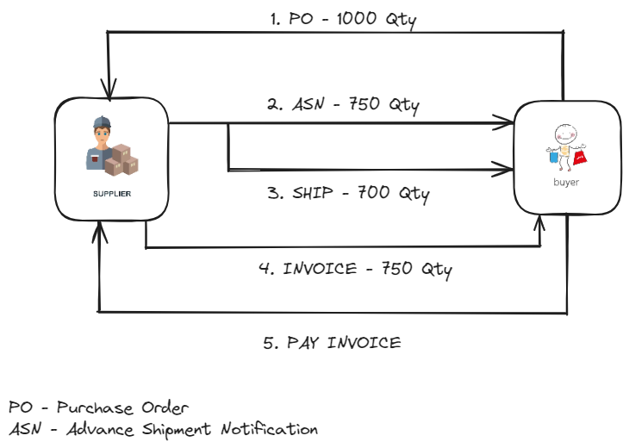
Conventional approach to supply chain management

Slide 5
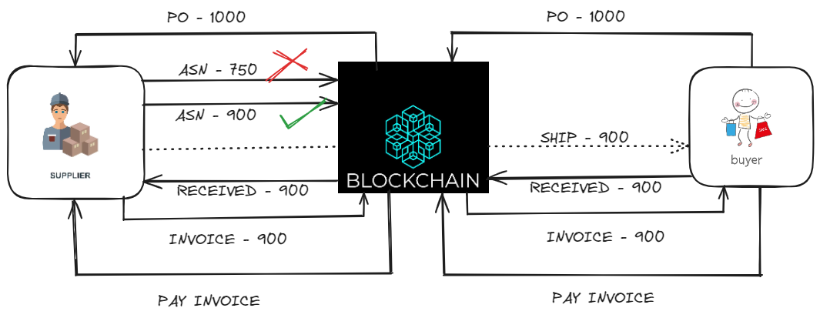
Integrating blockchain into the supply chain

Slide 6
Our solution

Slide 7

Chain-bills

Slide 8
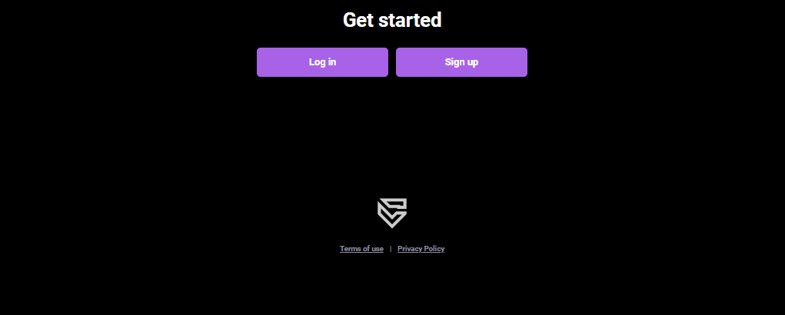
security

Slide 9
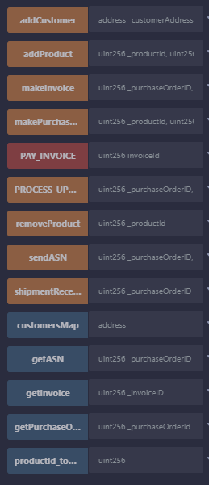
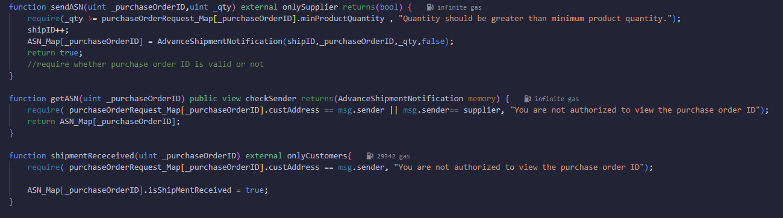
ReConciliation

Slide 10
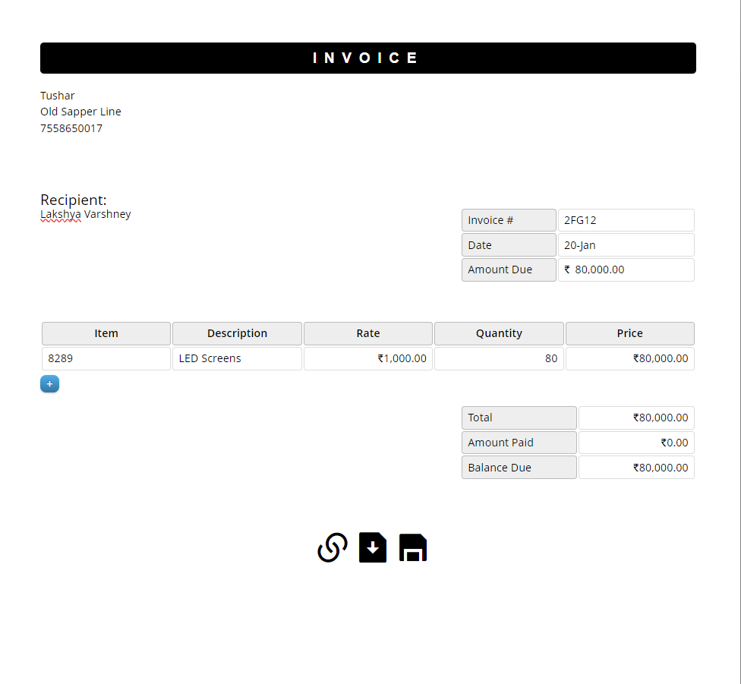
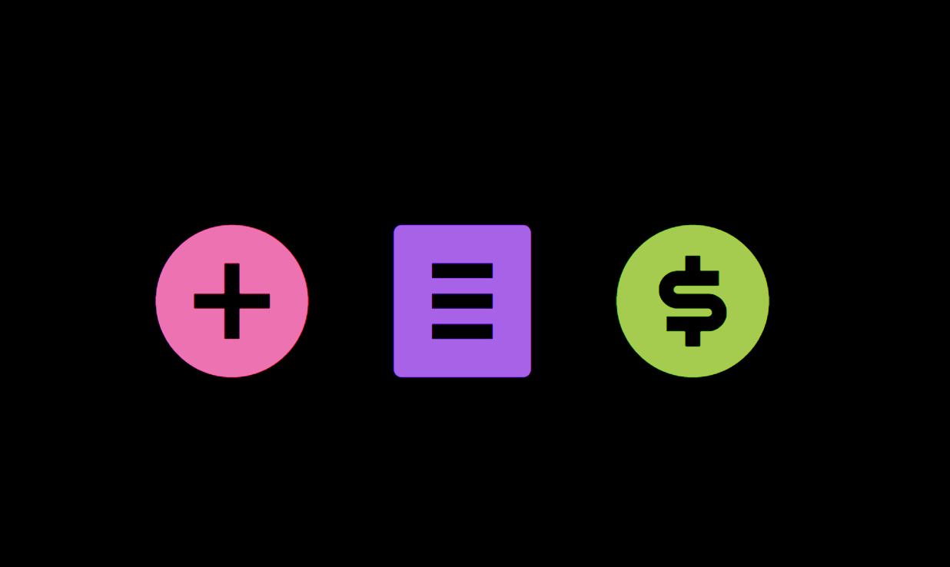
creation and management

Slide 11
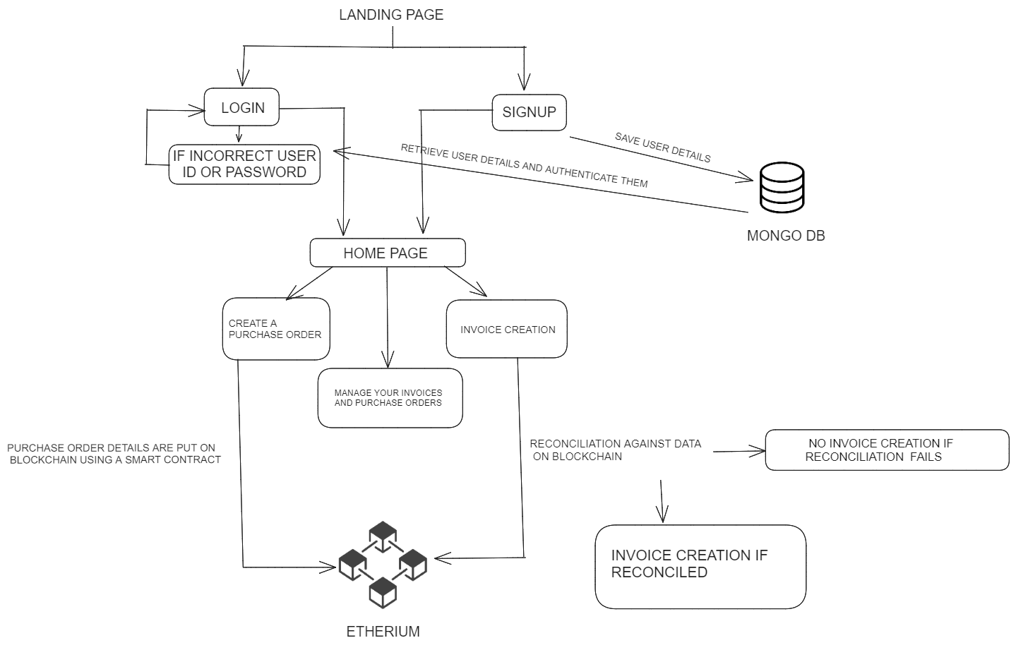
PRoject FLOW

Slide 12
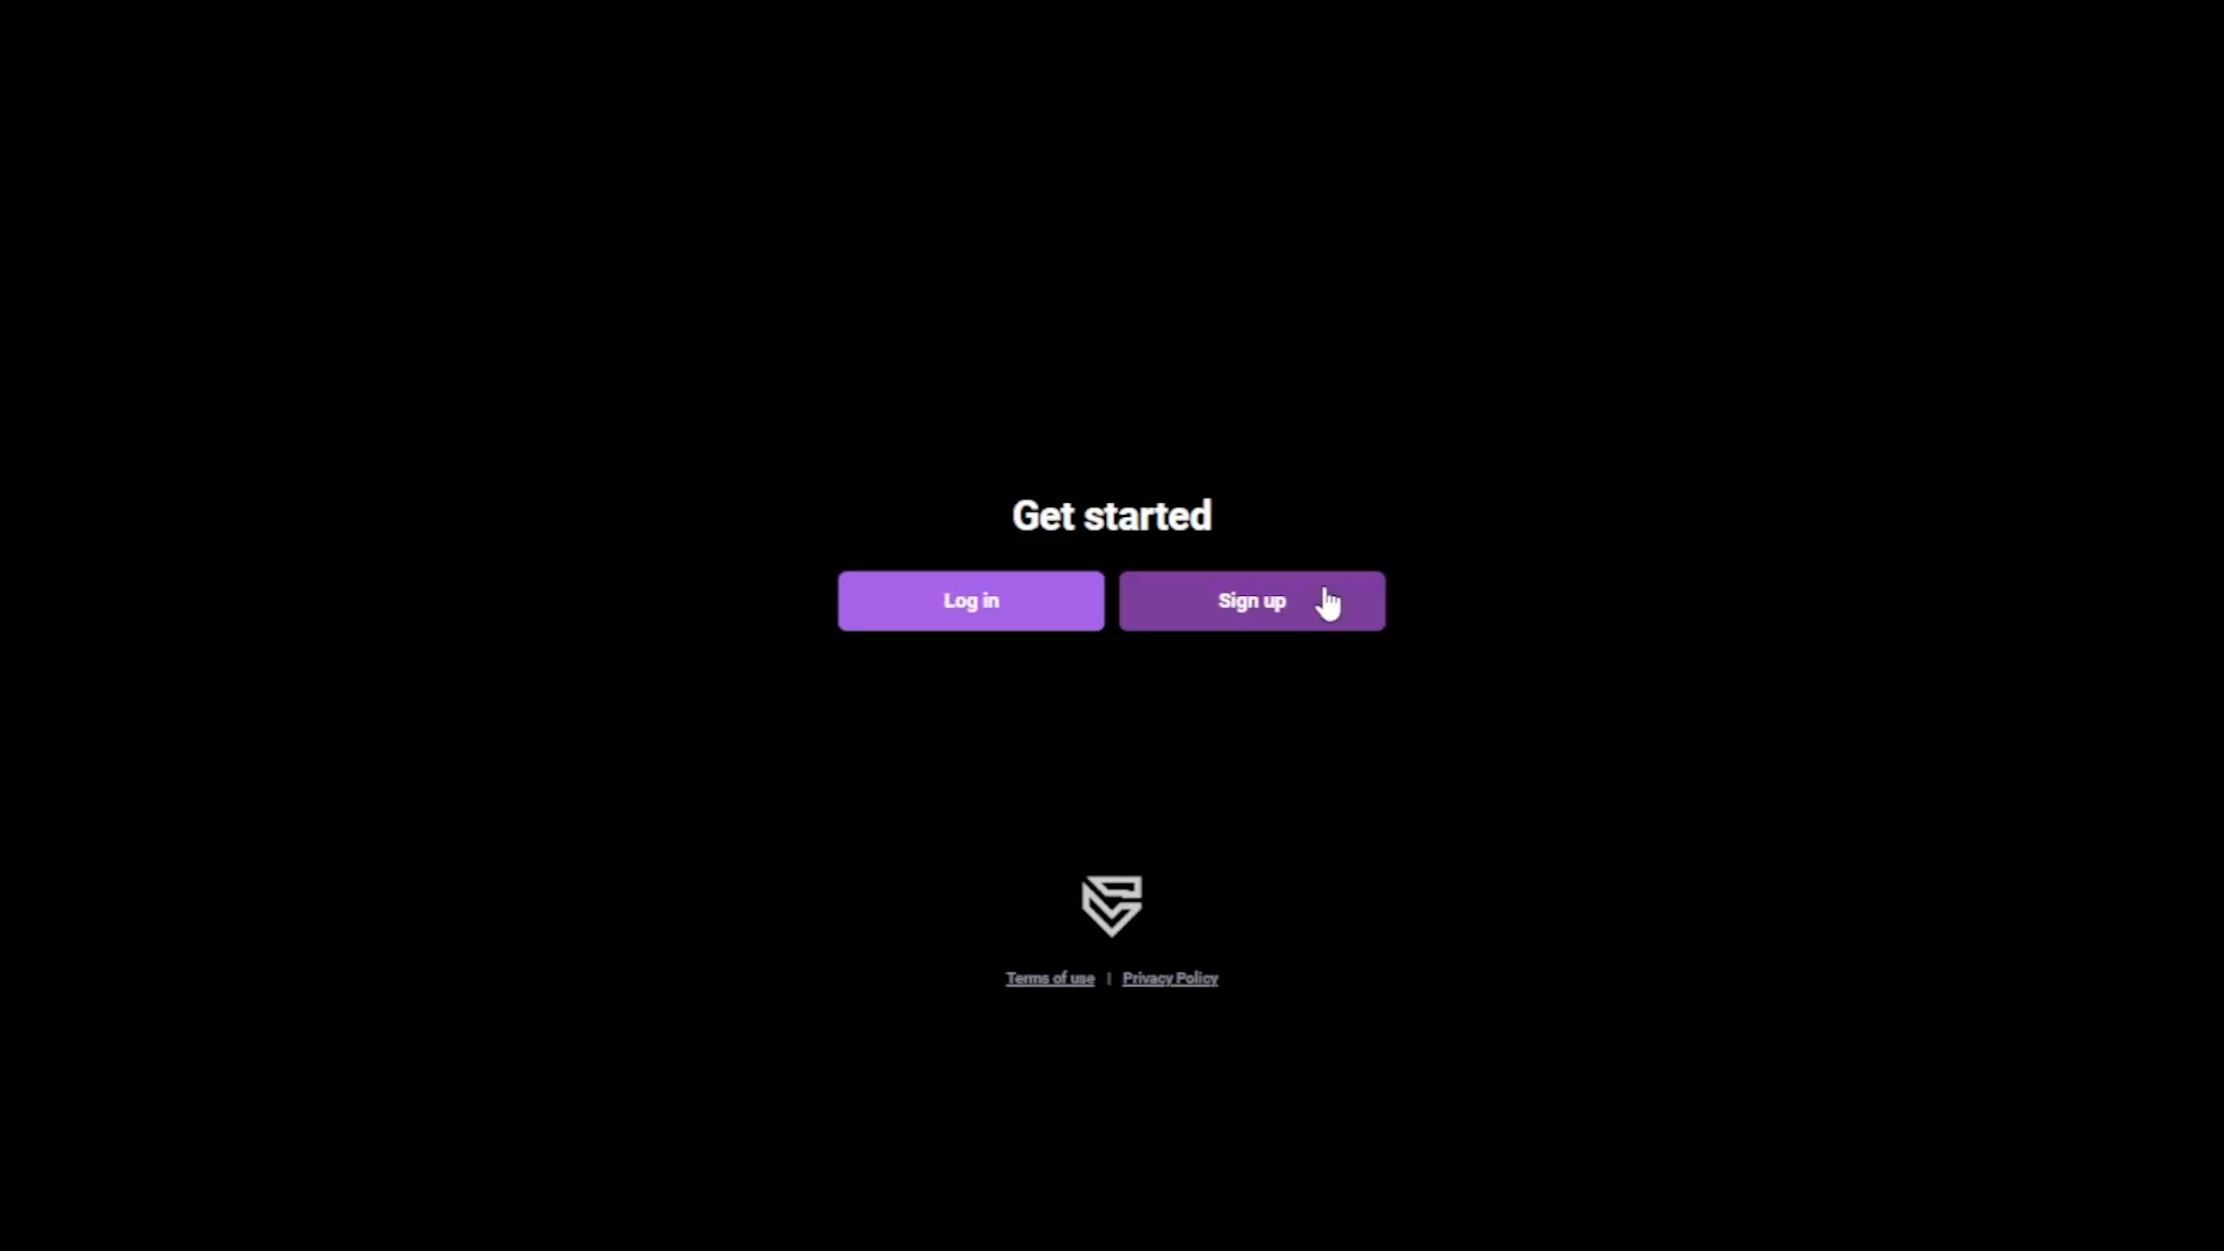

Slide 13
Usp??

Slide 14
Future ROADMAP
Dynamic Discounting
Advanced Fraud Detection Algorithms
Integrating other functions with smart contracts
3
2
1

Slide 15
LIMITATIONS

Slide 16
THANK YOU

